Slide 1

Student Stress Prediction
Predicting Student Stress for Actionable Interventions Using Machine Learning
This project aims to develop a robust machine learning model for multi-class stress prediction among students. By analyzing various stress factors, our goal is to identify key indicators and provide insights for effective interventions, thereby promoting academic success and mental well-being in educational settings.
Note: The dataset is for learning; values reflect typical student self-reports (not clinical labels).
DATA ANALYST STUDENT
Luis Pablo Aiello

Slide 2
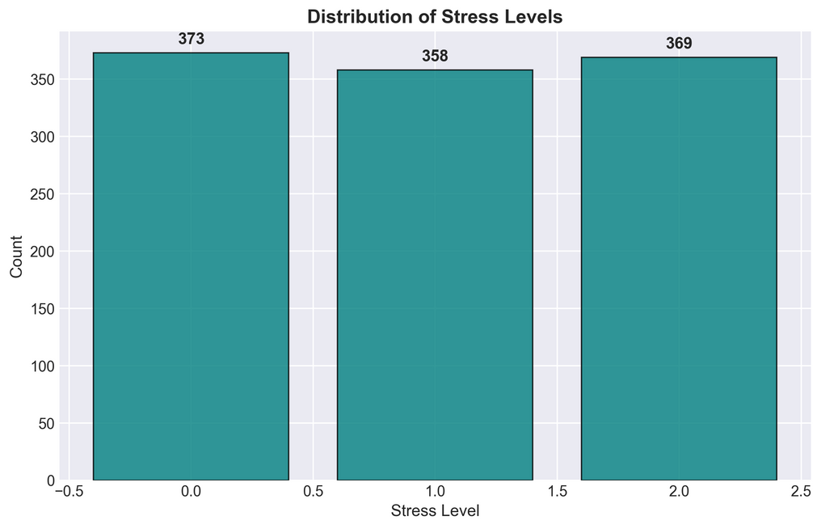
Dataset Snapshot: Characteristics and Source
Understanding the Underlying Causes and Their Impact on Today's Students
This dataset investigates the root causes of stress among students, derived from a nationwide survey.
It includes around 20 key features grouped under five scientifically identified categories:
🧠 Psychological Factors
anxiety_level
self_esteem
mental_health_history
depression
🏥 Physiological Factors
headache
blood_pressure
sleep_quality
breathing_problem
🌆 Environmental Factors
noise_level
living_conditions
safety
basic_needs
🎓 Academic Factors
academic_performance
study_load
teacher_student_relationship
future_career_concerns
🤝 Social Factors
social_support
peer_pressure
extracurricular_activities
bullying
Data Overview
Rows: ~1,100
Features: ~21 (all numeric)
Missing values: none
Duplicates: none
Target distribution (stress_level): {0: 373, 1: 358, 2: 369} → roughly balanced, so accuracy is a fair primary metric.
✅ Model-ready: numeric, balanced, clean
Source: Kaggle — Student Stress Monitoring dataset

Slide 3
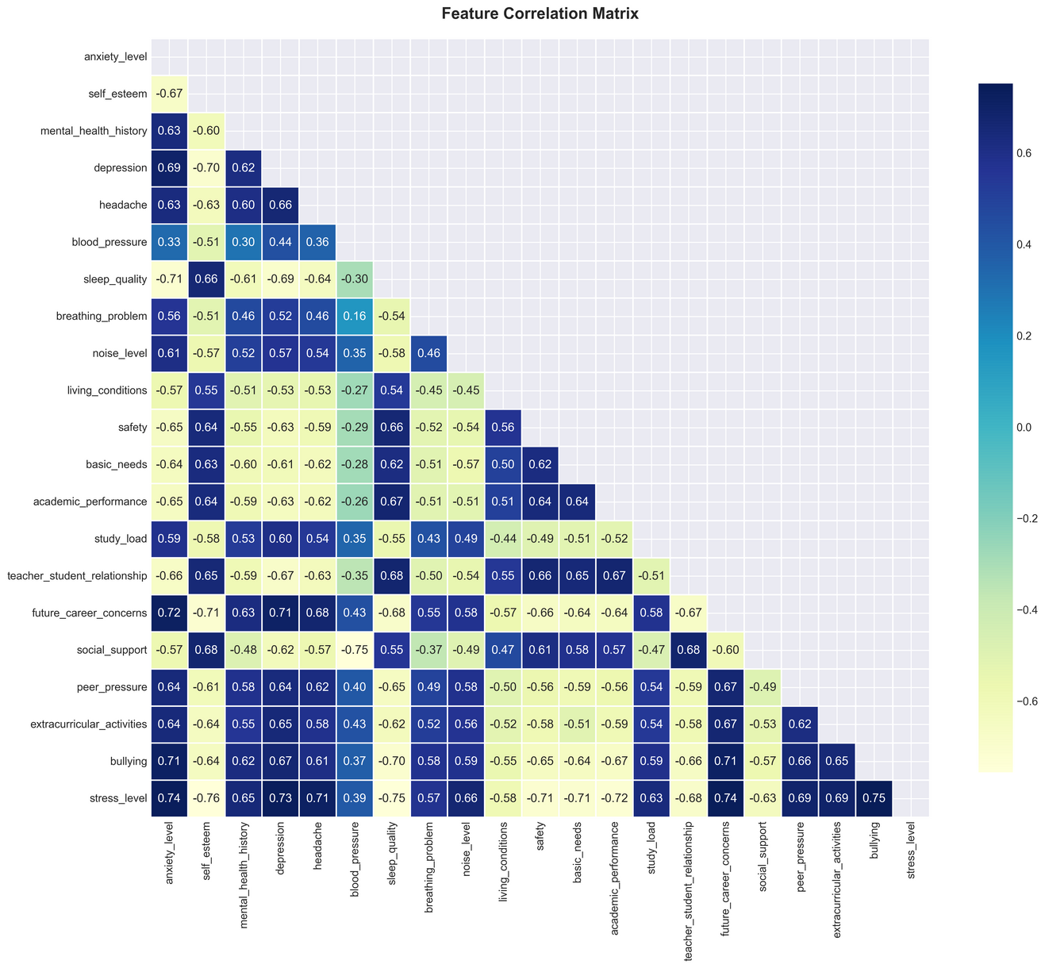
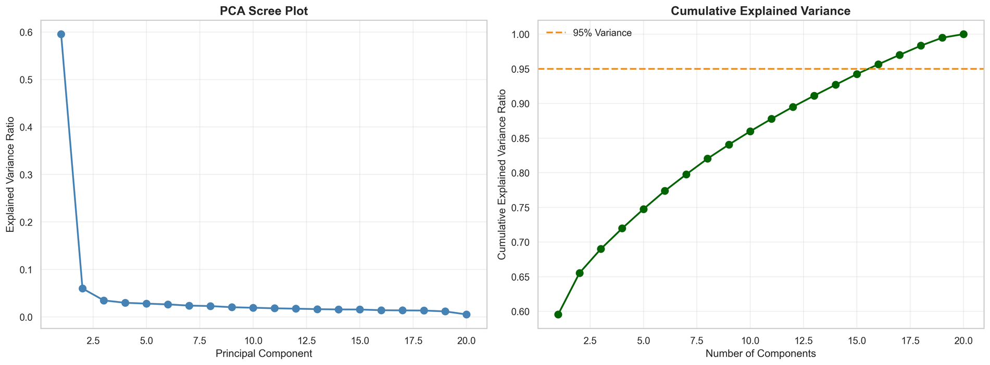
Exploratory Data Analysis
High-correlation pairs (|r| > 0.70):
The analysis reveals key trends in student stress factors, highlighting correlations with bullying, anxiety, and protective elements like sleep and self-esteem, crucial for effective interventions.
anxiety_level – future_career_concerns: r = 0.717
future_career_concerns – bullying: r = 0.711
anxiety_level – bullying: r = 0.710
depression – future_career_concerns: r = 0.707
anxiety_level – sleep_quality: r = −0.710
self_esteem – future_career_concerns: r = −0.713
blood_pressure – social_support: r = −0.753
We drop: anxiety_level, future_career_concerns, social_support
We keep: bullying, depression, sleep_quality, self_esteem, blood_pressure
About 16 components explain 95% of the variance; PCA can be used as an optional step for compact representations.

Slide 4
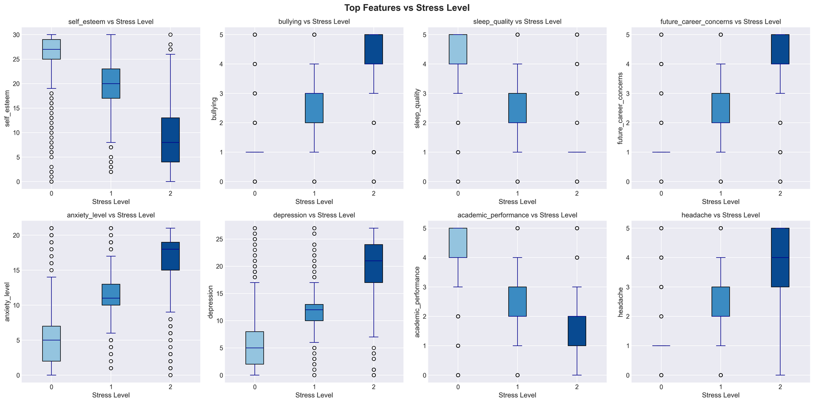
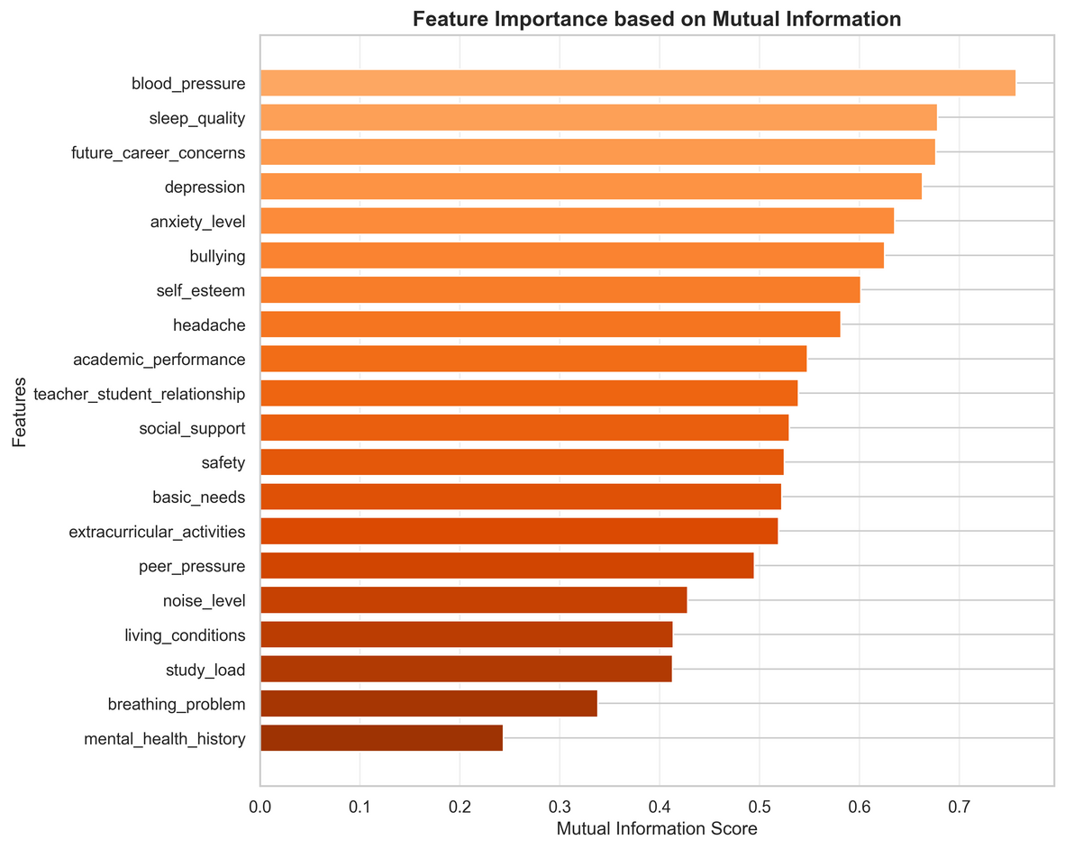
Stress Factors: Bullying, Anxiety, and Depression
Top MI features: blood_pressure, sleep_quality, future_career_concerns, depression, anxiety_level — these carry the most information about stress levels.
Key Stressors
Bullying, anxiety, and depression impact student well-being.
↑ stress → bullying, anxiety, depression, study_load, future_career_concerns, headache
↓ stress → sleep quality, self-esteem, academic_performance

Slide 5

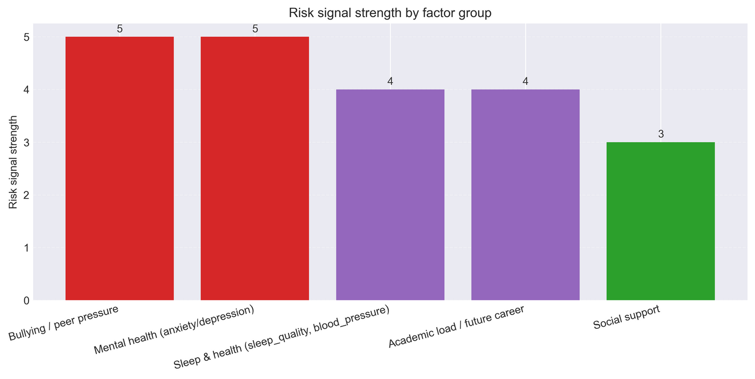
Recommendations:
Turn Exploratory Data Analysis into Actions
What the school/program should do:
Reduce social stressors: targeted anti-bullying / peer-pressure policies
Support mental health: counseling, early screening for anxiety/depression
Protect recovery: sleep & wellness / fatigue awareness
Lower academic pressure: review study load, deadlines, exam clustering
Guide the future: career mentoring to reduce uncertainty

Slide 6
Modeling Approach
Model | Test Accuracy
Random Forest | 0.8955
Gradient Boosting + hyperparams | 0.8955
Logistic Regression + RUS | 0.8909
Logistic Regression + SMOTE | 0.8909
Logistic Regression | 0.8864
Logistic Regression + ROS | 0.8864
Random Forest + hyperparams | 0.8818
AdaBoost + hyperparams | 0.8818
AdaBoost | 0.8773
Gradient Boosting | 0.8591
Decision Tree | 0.8545
KNN (k=17, CI-LCB) | 0.8545
Selecting Robust Models for Accurate Predictions
Target: multi-class (0, 1, 2)
Shared preprocessing → same for every model
Models: KNN, Logistic Regression, Decision Tree
Ensembles: Random Forest, Gradient Boosting, AdaBoost
Resampling runs: LogReg + SMOTE / ROS / RUS
Evaluation: accuracy + macro precision/recall/F1
In our project, we employed leak-free pipelines to ensure model integrity while exploring various algorithms, including KNN, Logistic Regression, and Tree-based models. By utilizing ensemble techniques and resampling strategies, we enhanced predictive performance. This approach not only improves accuracy but also provides a reliable framework for deploying effective solutions in real-world scenarios.

Slide 7
Results (Global Comparison)
Results — which models performed best?
Model | Accuracy | Macro Precision | Macro Recall | Macro F1 | Notes
LogReg + SMOTE | 0.8909 | 0.8863 | 0.8868 | 0.8863 | Best recall for stressed classes (1, 2); slightly lower precision.
AdaBoost | 0.8773 | 0.8809 | 0.8776 | 0.8774 | Good overall but just below the top cluster.
Logistic Regression | 0.8864 | 0.8888 | 0.8865 | 0.8873 | Strong, easy to explain & deploy.
LogReg + ROS | 0.8864 | 0.888 | 0.8865 | 0.8871
LogReg + RUS | 0.8909 | 0.8933 | 0.891 | 0.8918 | Simpler; improves class-0 recall; very close to RF.
Random Forest | 0.8955 | 0.896 | 0.8956 | 0.8953 | Most diagonal confusion matrix; very balanced across 0 / 1 / 2.
Gradient Boosting (tuned) | 0.8955 | 0.8598 | 0.8594 | 0.8596 | Ties RF in accuracy after HP tuning; confirm macro balance.
Decision Tree | 0.8545 | 0.8558 | 0.8551 | 0.8541 | Lower, as expected; useful for teaching/baseline only.
KNN (k=17) | 0.8545 | 0.8693 | 0.8552 | 0.856 | Lower, as expected; useful for teaching/baseline only.

Slide 8
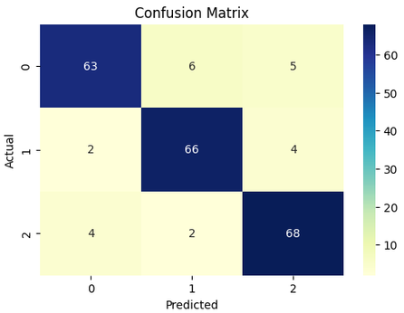
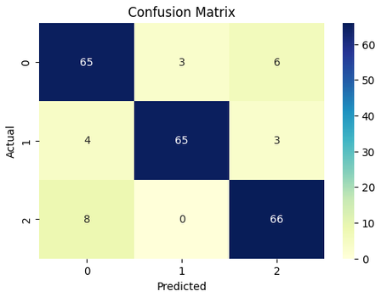

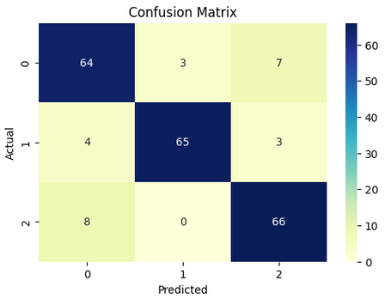
Per-Class Performance & Confusion Matrix
 | Per-class Precision | Per-class Precision | Per-class Precision | Per-class Recall | Per-class Recall | Per-class Recall | Per-class F1 | Per-class F1 | Per-class F1
Model | Class 0 | Class 1 | Class 2 | Class 0 | Class 1 | Class 2 | Class 0 | Class 1 | Class 2
Random Forest | 0.913 | 0.8919 | 0.8831 | 0.8514 | 0.9167 | 0.9189 | 0.8811 | 0.9041 | 0.9007
LogReg + RUS | 0.8442 | 0.9559 | 0.88 | 0.8784 | 0.9028 | 0.8919 | 0.8609 | 0.9286 | 0.8859
LogReg + SMOTE | 0.8421 | 0.8649 | 0.8533 | 0.8649 | 0.9167 | 0.8919 | 0.8533 | 0.9362 | 0.8859
Logistic Regression | 0.8421 | 0.9559 | 0.8684 | 0.8649 | 0.9028 | 0.8919 | 0.8533 | 0.9286 | 0.880
Gradient Boosting | 0.8267 | 0.9014 | 0.8514 | 0.8378 | 0.8889 | 0.8514 | 0.8322 | 0.8951 | 0.8514
Table: Random Forest — Per-Class Metrics
Class | Precision | Recall | F1-score
0 (low) | 0.9130 | 0.8514 | 0.8811
1 (medium) | 0.8919 | 0.9167 | 0.9041
2 (high) | 0.8831 | 0.9189 | 0.9007
=== Random Forest ===
=== LogReg + RUS ===
=== LogReg + SMOTE ===
=== Logistic Regression===

Slide 9
Model Selection & Top Features
Recommended Models for Deployment
Model | Why keep it | When to use it | Export status / notes
Random Forest | Best overall balance; top accuracy (0.8955); diagonal confusion | General-purpose, demo, default model | Exported as .pkl; uses full feature schema
Gradient Boosting (tuned) | Ties RF after HP tuning; competitive on same schema | When you can afford slightly heavier model | Exported if tuned pipeline was fitted
LogReg + SMOTE | Same accuracy band (0.8909) but better recall on stressed 1/2 | When “catch stressed students” is the KPI | Exported as .pkl; good for explanations
LogReg + RUS | Very close (0.8909) but simpler and interpretable | When stakeholders want coefficients and simplicity | Exported as .pkl; maps to same feature list
Top signals: blood_pressure, sleep_quality, social_support, anxiety_level, depression, self_esteem, academic_performance, study_load, future_career_concerns, bullying. That tells us the model is learning the same story we saw in EDA.

Slide 10
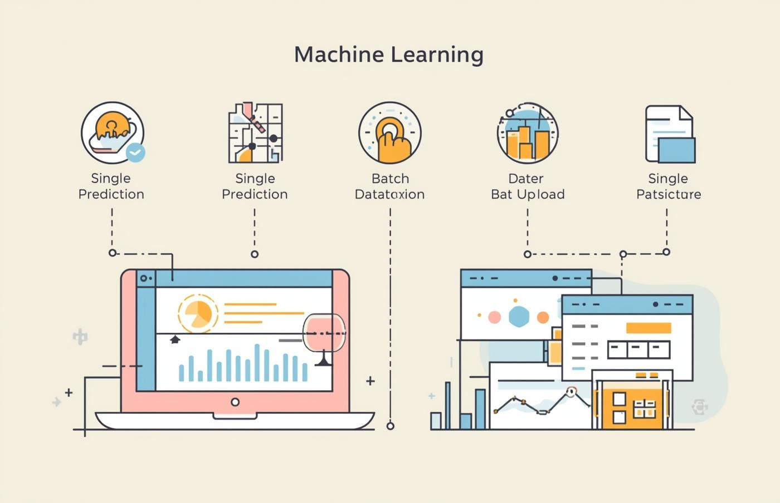
Demo Overview: Predictions Made Easy
Feature | Effect on stress | Explanation (short)
self_esteem | ↑ → ↓ stress | more confidence, less distress
mental_health_history | ↑ → ↑ stress | past issues → higher risk
depression | ↑ → ↑ stress | direct psychological load
headache | ↑ → ↑ stress | physical symptom of stress
blood_pressure | ↑ → ↑ stress | physiological activation
sleep_quality | ↑ → ↓ stress | better sleep → better coping
breathing_problem | ↑ → ↑ stress | health discomfort → more stress
noise_level | ↑ → ↑ stress | worse environment → more stress Kaggle
living_conditions | ↑ → ↓ stress | better housing → safer → calmer Kaggle
safety | ↑ → ↓ stress | feeling safe lowers stress
basic_needs | ↑ → ↑ stress | in this dataset “needs not met” → more stress Kaggle
academic_performance | ↑ → ↓ stress | performing well → less pressure Medium
study_load | ↑ → ↑ stress | heavier workload → more stress Medium
teacher_student_relationship | ↑ → ↓ stress | support from teachers helps
peer_pressure | ↑ → ↑ stress | social pressure is a stressor ✅ (fixed)
extracurricular_activities | ↑ → ↓ stress | engagement can buffer stress ✅ (fixed) Medium
bullying | ↑ → ↑ stress | direct social stressor
Predictions Simplified
Easily make predictions with individual or bulk data inputs.
Link: → Student Stress Prediction

Slide 11

Stress Signals
Understanding Key Indicators and Performance Metrics
The analysis revealed crucial stress signals affecting students, such as bullying, anxiety, and depression. Our models effectively predicted these indicators, demonstrating high accuracy and relevance. By addressing these challenges, we can implement actionable interventions that provide targeted support, ultimately fostering a healthier academic environment. Continuous monitoring and adaptation will enhance our response strategies.

Slide 12
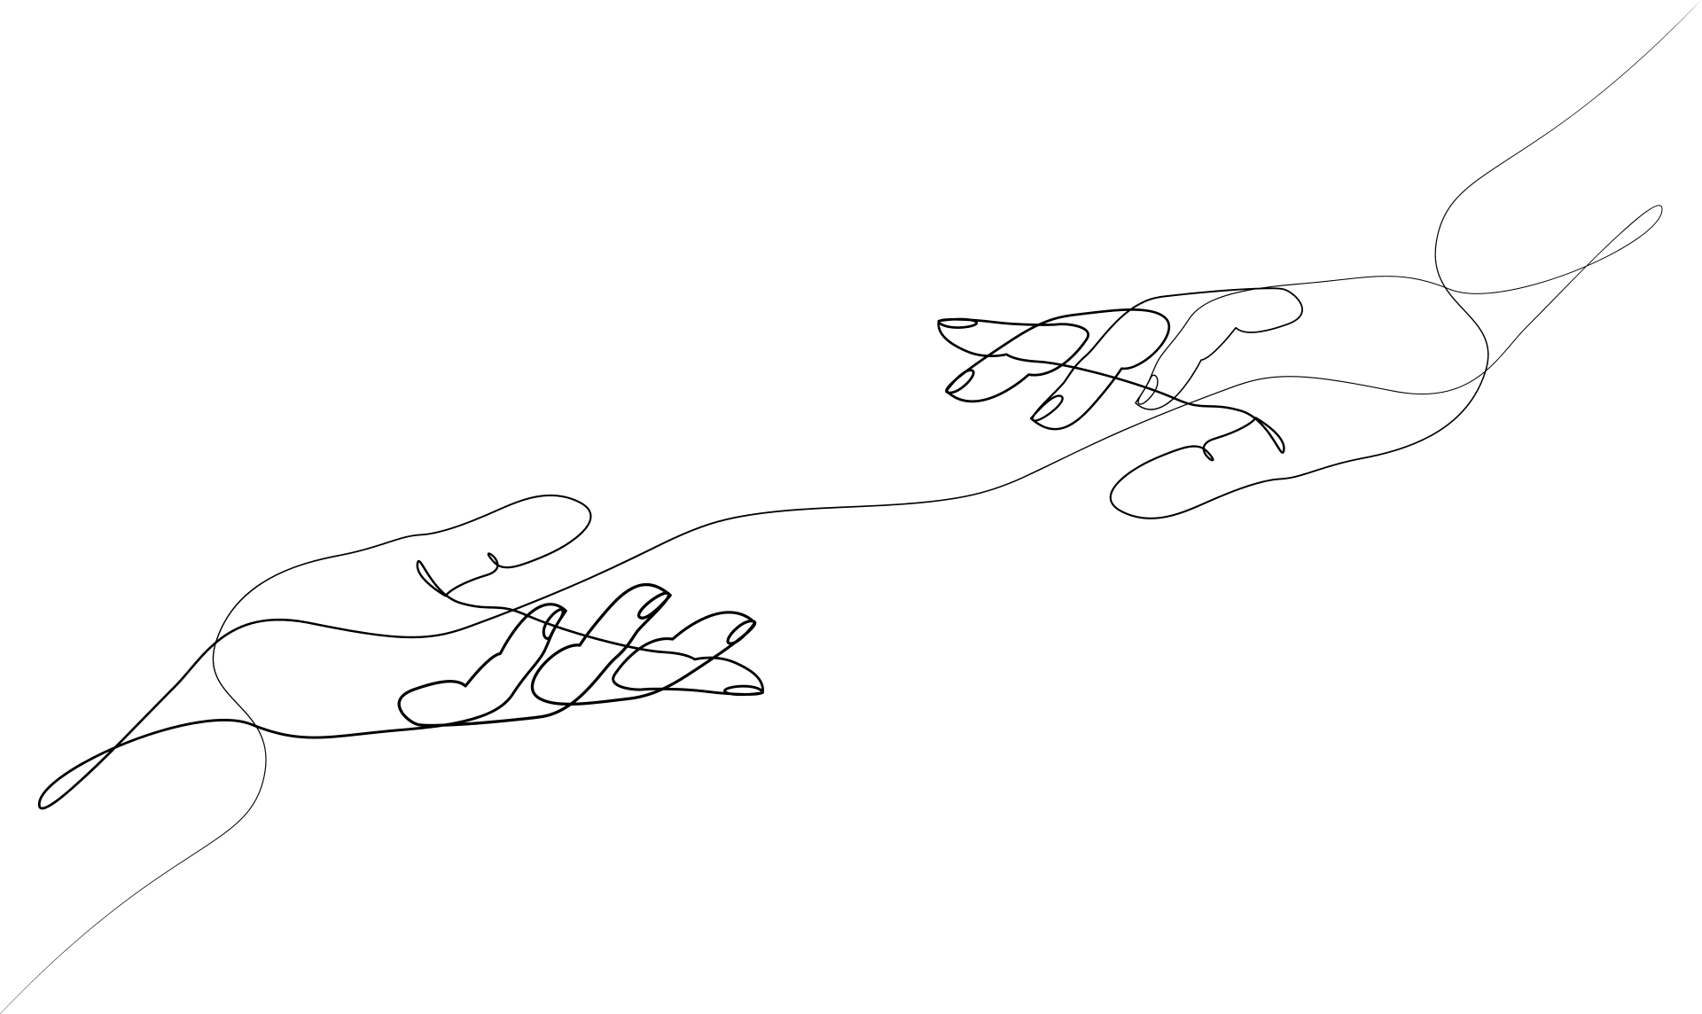
WEBSITE
www.reallygreatsite.com
Student Stress
Feel free to reach out with any questions!
EMAIL
hello@reallygreatsite.com
PHONE
123-456-7890

